Slide 1
Test Revision

Slide 2

Skill Development / Guided Practice
CFU 1
What is the first thing you need to mention when describing a force?
Describing Forces
When describing a force, you need to include:
What is pushing / pulling what
Any changes to the objects’
Speed
Direction
Shape
The tennis racket is pushing the ball. This is causing the ball to change speed, direction, and shape.
CFU 2
What three things might a force change about an object?
Vocabulary
force (noun) any push or pull that happens when two objects interact applied force (noun) a simple push or pull
Notes:
CFU 1: popsticks
CFU 2: popsticks

Slide 3

Skill Development / Guided Practice
Reminder
When describing a force, you need to include: What is pushing / pulling what Any changes to the objects’ Speed Direction Shape
Describe the force at work in the picture below.
The ________ is pushing / pulling the ________. This is causing the ________ to change ________.
Vocabulary
force (noun) any push or pull that happens when two objects interact applied force (noun) a simple push or pull
Notes:
1 min → share → popsticks

Slide 4
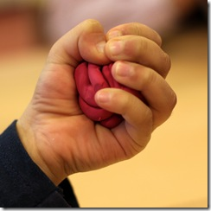
Skill Development / Guided Practice
Reminder
When describing a force, you need to include: What is pushing / pulling what Any changes to the objects’ Speed Direction Shape
Describe the force at work in the picture below.
The ________ is pushing / pulling the ________. This is causing the ________ to change ________.
Vocabulary
force (noun) any push or pull that happens when two objects interact applied force (noun) a simple push or pull
Notes:
45 s → share → popsticks

Slide 5
Skill Development / Guided Practice
Describing and Drawing Forces
When describing forces, you need to:
Draw a diagram with labelled force arrows.
Do the maths
Add the forces going in the same direction
Subtract the forces going in opposite directions
Describe the net force
Balanced (there is no net force)
Unbalanced (state the net force and its direction)
Paul and Pamela are pushing a box together. Paul is pushing with 500 N and Pamela is pushing with 450 N.
1.
2.
3.
500 N
500 + 450 = 950
The net force is 950 N to the right.
450 N

Slide 6
Skill Development / Guided Practice
Vocabulary
unbalanced (adjective) forces on an object are not 0 N and will cause a change balanced (adjective) forces on an object are exactly 0 N and will not cause a change
Describing and Drawing Forces
Draw a diagram with labelled force arrows.
Do the maths
Add the forces going in the same direction
Subtract the forces going in opposite directions
Describe the net force
Balanced (there is no net force)
Unbalanced (state the net force and its direction)
Sam and Ash are cracking a Christmas cracker. Sam is pulling with 350 N and Ash is pulling with 475 N.

Slide 7
Skill Development / Guided Practice
Vocabulary
unbalanced (adjective) forces on an object are not 0 N and will cause a change balanced (adjective) forces on an object are exactly 0 N and will not cause a change
Describing and Drawing Forces
Draw a diagram with labelled force arrows.
Do the maths
Add the forces going in the same direction
Subtract the forces going in opposite directions
Describe the net force
Balanced (there is no net force)
Unbalanced (state the net force and its direction)
Bill and Kelly are pushing a car up a hill. Bill is pushing with 550 N and Kelly is pushing with 525 N. The Earth is pulling the car down the hill with 1000 N of force.

Slide 8
Skill Development / Guided Practice
Describing and Drawing Forces
When describing forces, you need to:
Draw a diagram with labelled force arrows.
Remember: friction will resist movement!
Do the maths
Add the forces going in the same direction
Subtract the forces going in opposite directions
Describe the net force
Balanced (there is no net force)
Unbalanced (state the net force and its direction)
A block of ice is sliding down a hill. The Earth is pulling the block down the hill with 50 N of force. There are 3 N of friction between the ice block and the ground.
F_{Friction}
3 N
1.
2.
3.
F_{Earth’s Pull}
50 N
50 - 3 = 47
The net force is 47 N down the hill. The forces are not balanced.
(Arrows not to scale)

Slide 9
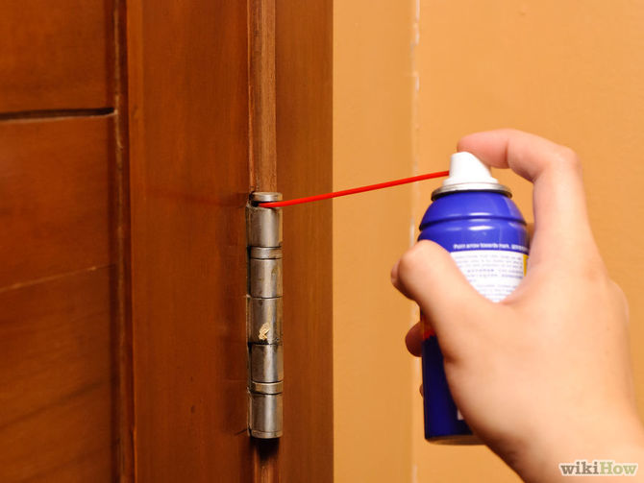
Skill Development / Guided Practice
CFU 1
Which method of friction reduction is being used?
In situations where friction is reduced, you need to:
Identify which method is being used.
Explain how friction is being reduced in that situation.
This is an example of lubrication. The oil coats the metal, making it slippery.
CFU 2
How does this method work in this situation?
Reminders:
Lubrication makes things slippery Balls and rollers make things roll, which produces less friction than pushing or sliding Levitation reduces contact between surface Streamlined objects are smooth and rounded

Slide 10
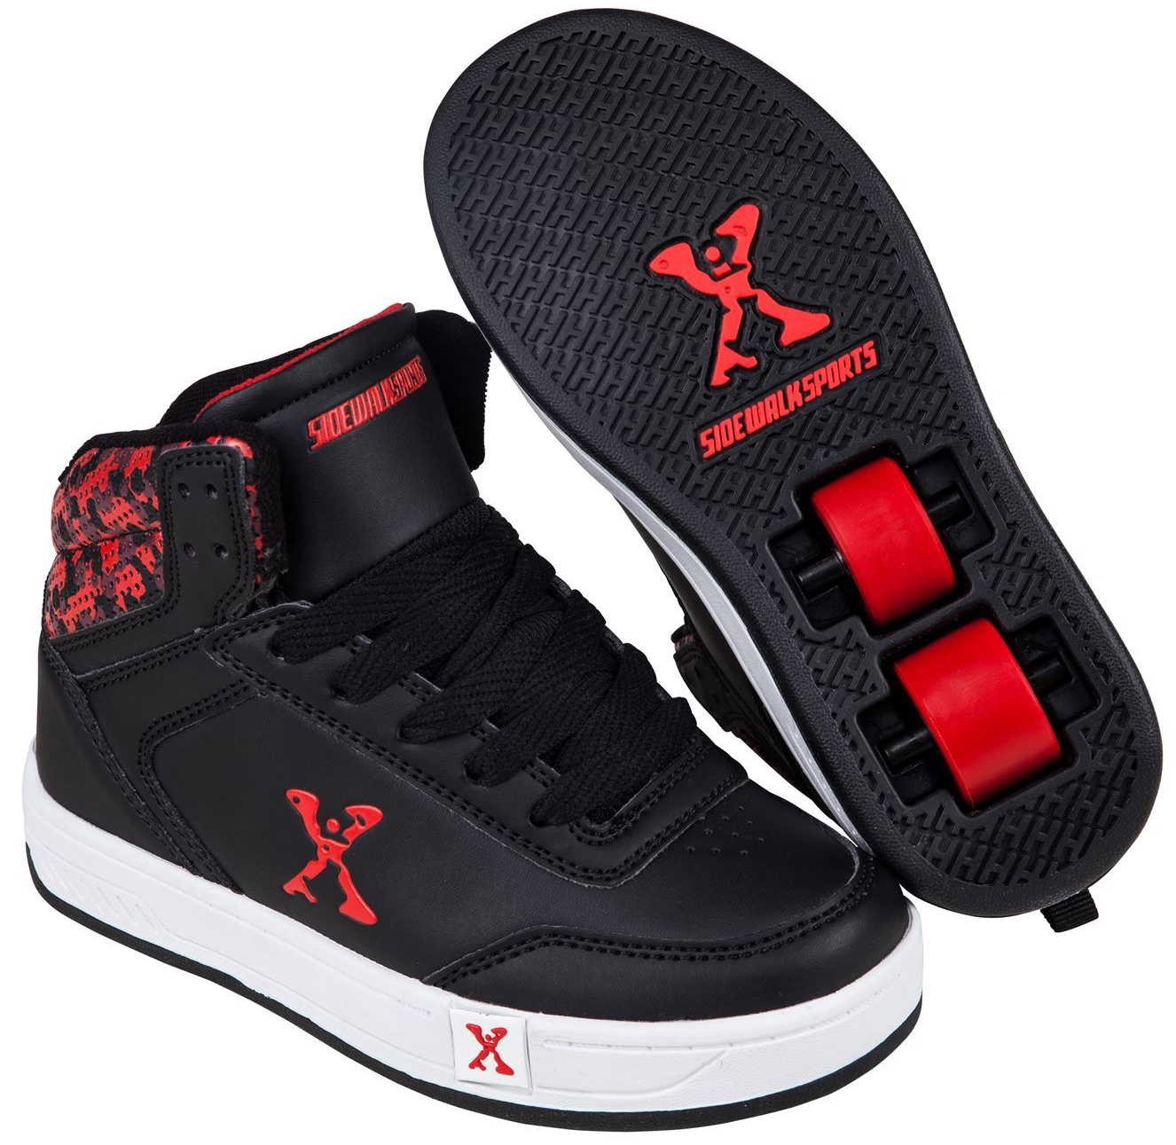
Skill Development / Guided Practice
CFU 1
Which method of friction reduction is being used?
In situations where friction is reduced, you need to:
Identify which method is being used.
Explain how friction is being reduced in that situation.
This is an example of a roller. The wheels in the shoes roll, which produces less friction than pushing or sliding.
CFU 2
How does this method work in this situation?
Reminders:
Lubrication makes things slippery Balls and rollers make things roll, which produces less friction than pushing or sliding Levitation reduces contact between surface Streamlined objects are smooth and rounded

Slide 11
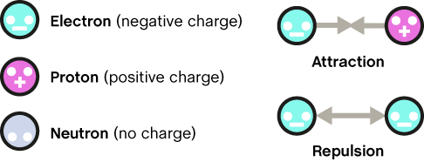
Skill Development / Guided Practice
CFU 1
What would happen if two positively charged objects were close to each other?
Electrostatic Force
A difference in the net charge of two objects can create forces if the two objects are close enough.
Different (unlike) charges will be pulled towards each other (attracted)
Similar (like) charges will be pushed away from each other (repelled)
Neutral objects do not push each other away, but they are attracted to any charged object
CFU 2
What would happen if a positively charged object and a negatively charged object were close to each other?
CFU 3
What would happen if a neutral object and a negatively charged object were close to each other?
Vocabulary
like (adjective) similar or the same unlike (adjective) different

Slide 12
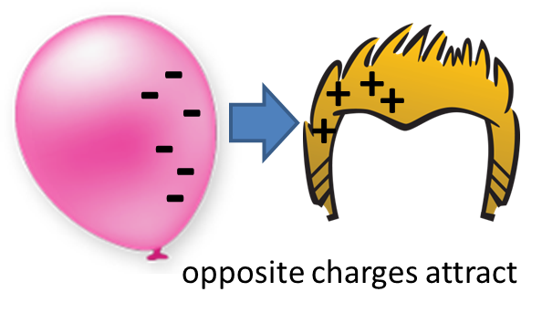
Skill Development / Guided Practice
CFU 1
Are there two different charges?
Predicting Electrostatic Force
Predict what will happen
Different charges are attracted
Similar charges are repelled
Neutral objects are attracted to charged objects
Explain why it will happen
Billie rubs a balloon on her hair, which moves negative charges from her hair to the balloon. What will happen next and why?
The balloon and her hair will be ________ because they have ________ charges.
CFU 2
Are there two similar charges?
CFU 3
Is there a neutral object and a charged object?
Vocabulary
attracted (adjective) pulled together repelled (adjective) pushed apart

Slide 13
Skill Development / Guided Practice
CFU 1
Are there two different charges?
Predicting Electrostatic Force
Predict what will happen
Different charges are attracted
Similar charges are repelled
Neutral objects are attracted to charged objects
Explain why it will happen
Mary rubs a second balloon on her hair, then puts it next to Billie’s. What will happen next and why?
The two balloons will be ________ because they have ________ charges.
CFU 2
Are there two similar charges?
CFU 3
Is there a neutral object and a charged object?
Vocabulary
attracted (adjective) pulled together repelled (adjective) pushed apart

Slide 14
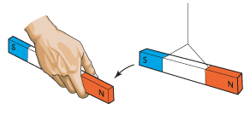
Skill Development / Guided Practice
CFU 1
Which two poles are near each other?
Predicting Magnetism
Predict what will happen
Different poles are attracted
Similar poles are repelled
Iron, nickel and cobalt objects will be magnetised and attracted to any magnet
Explain why it will happen
The two magnets will be ________ because…
CFU 2
What is going to happen to the two magnets, and why?

Slide 15
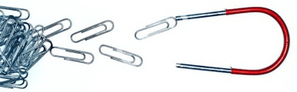
Skill Development / Guided Practice
CFU 1
Are there two magnets in this picture?
Predicting Magnetism
Predict what will happen
Different poles are attracted
Similar poles are repelled
Iron, nickel and cobalt objects will be magnetised and attracted to any magnet
Explain why it will happen
CFU 2
What is going to happen to the two objects, and why?

